Slide 1

Computer Science An Overview
13th Edition, Global Edition
Chapter 8
Data Abstractions

Slide 2
Chapter 8: Data Abstractions
8.1 Basic Data Structures
8.2 Related Concepts
8.3 Implementing Data Structures
8.4 A Short Case Study
8.5 Customized Data Types
8.6 Classes and Objects
8.7 Pointers in Machine Language

Slide 3
8.1 Basic Data Structures
Arrays
Aggregates
Lists
  Stacks
  Queues
Trees

Slide 4
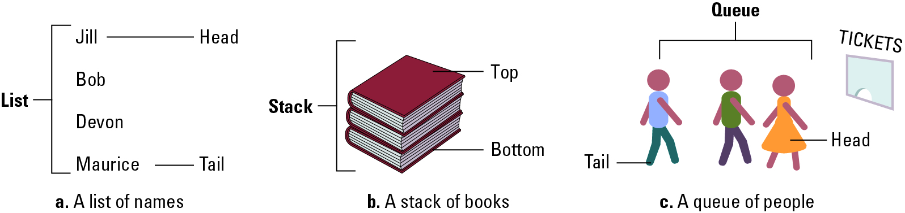
Figure 8.1 Lists, stacks, and queues

Slide 5
Terminology for Arrays
  Array: A block of data whose entries are of same type
A two dimensional array consists for rows and columns
Indices are used to identify positions

Slide 6
Terminology for Aggregates
  Aggregate: A block of data items that might be of different type or sizes
  Each data item is called a field
  Fields are usually accessed by name

Slide 7
Terminology for Lists
List: A collection of data whose entries are arranged sequentially
Head: The beginning of the list
Tail: The end of the list

Slide 8
Terminology for Stacks
Stack: A list in which entries are removed and inserted only at the head
LIFO: Last-in-first-out
Top: The head of list (stack)
Bottom or base: The tail of list (stack)
Pop: To remove the entry at the top
Push: To insert an entry at the top

Slide 9
Terminology for Queues
Queue: A list in which entries are removed at the head and are inserted at the tail
FIFO: First-in-first-out

Slide 10
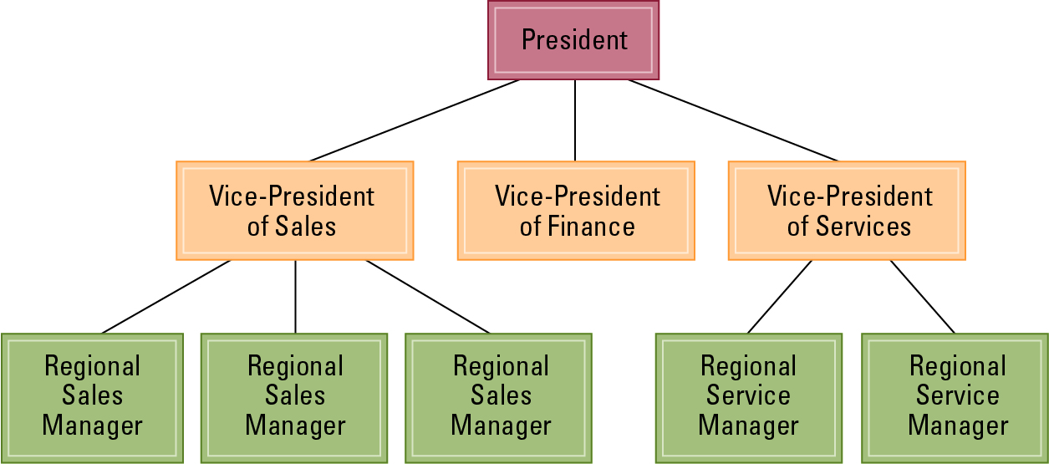
Figure 8.2 An example of an organization chart

Slide 11
Terminology for a Tree
Tree: A collection of data whose entries have a hierarchical organization
Node: An entry in a tree
Root node: The node at the top
Terminal or leaf node: A node at the bottom

Slide 12
Terminology for a Tree (continued)
Parent: The node immediately above a specified node
Child: A node immediately below a specified node
Ancestor: Parent, parent of parent, etc.
Descendent: Child, child of child, etc.
Siblings: Nodes sharing a common parent

Slide 13
Terminology for a Tree (continued)
Binary tree: A tree in which every node has at most two children
Depth: The number of nodes in longest path from root to leaf

Slide 14
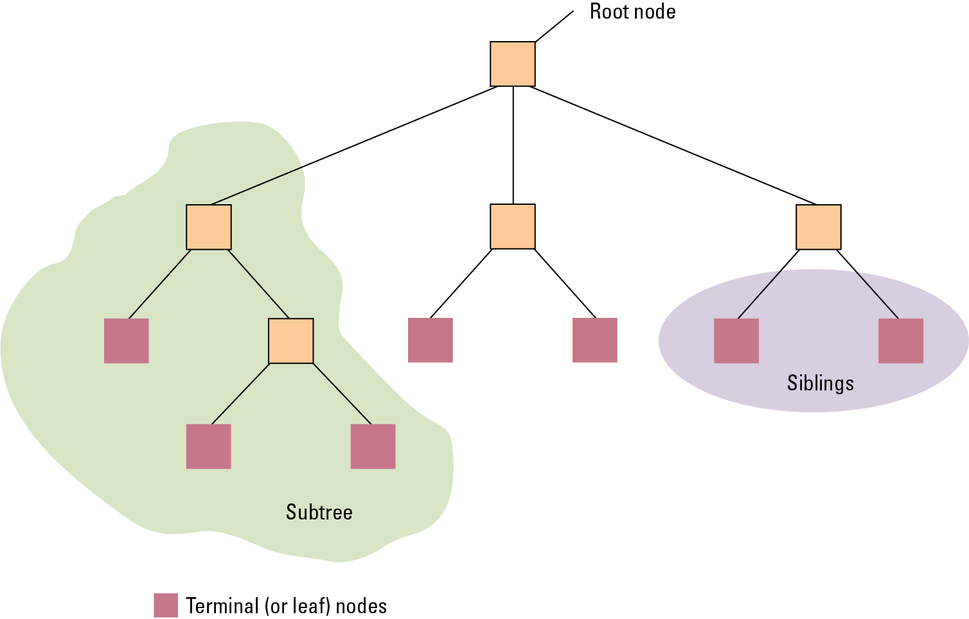
Figure 8.3 Tree terminology

Slide 15
8.2 Related Concepts
Abstraction
  Shield users (application software) from details of actual data storage
Static vs. Dynamic Structure
  Does the shape and size change over time?
Pointer
  A storage area that contains the address where data is stored

Slide 16
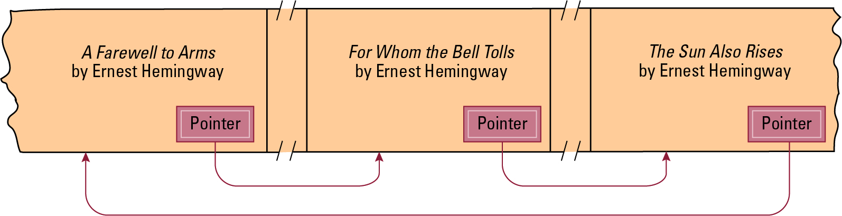
Figure 8.4 Novels arranged by title but linked according to authorship

Slide 17
8.3 Implementing Data Structures
High Level Languages provide certain data structures as primitives
These data structures are translated into machine-language instructions to manipulate data stored in main memory

Slide 18
Storing Arrays
Memory address of a particular cell can be computed
Row-major order versus column major order
An Address polynomial describes how to access the data in a certain array element

Slide 19
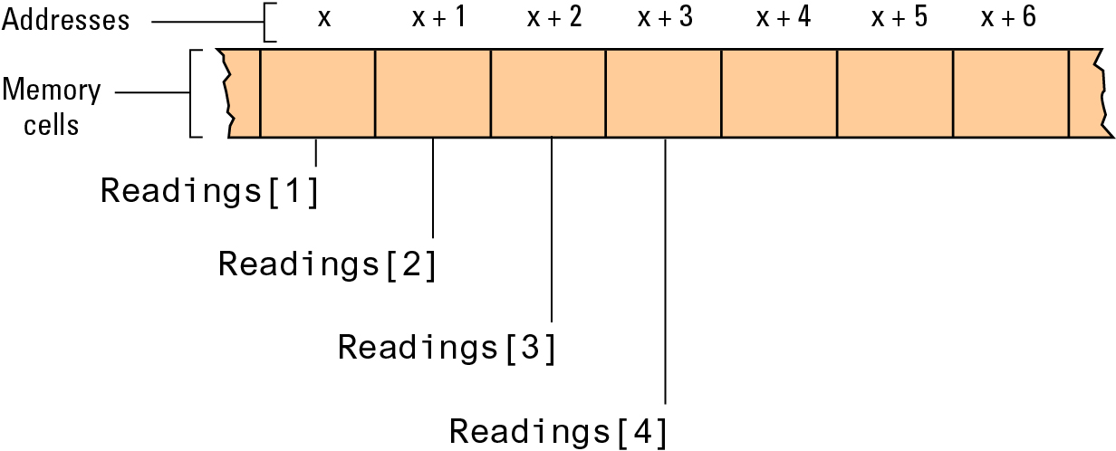
Figure 8.5 The array of temperature readings stored in memory starting at address x

Slide 20
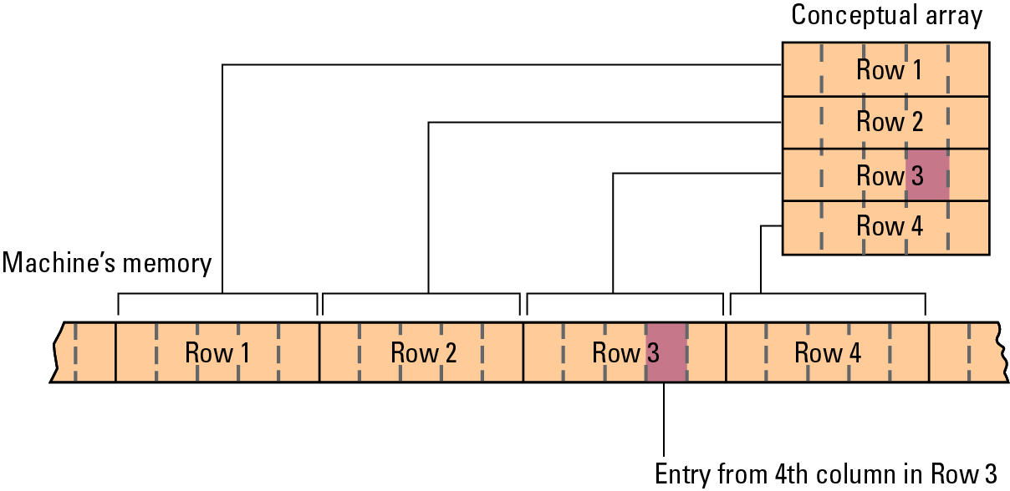
Figure 8.6 A two-dimensional array with four rows and five columns stored in row major order

Slide 21
Storing Aggregates
Fields can be stored one after the other in a contiguous block:
  Memory cell address of each field can be computed
Fields can be stored in separate locations identified by pointers

Slide 22
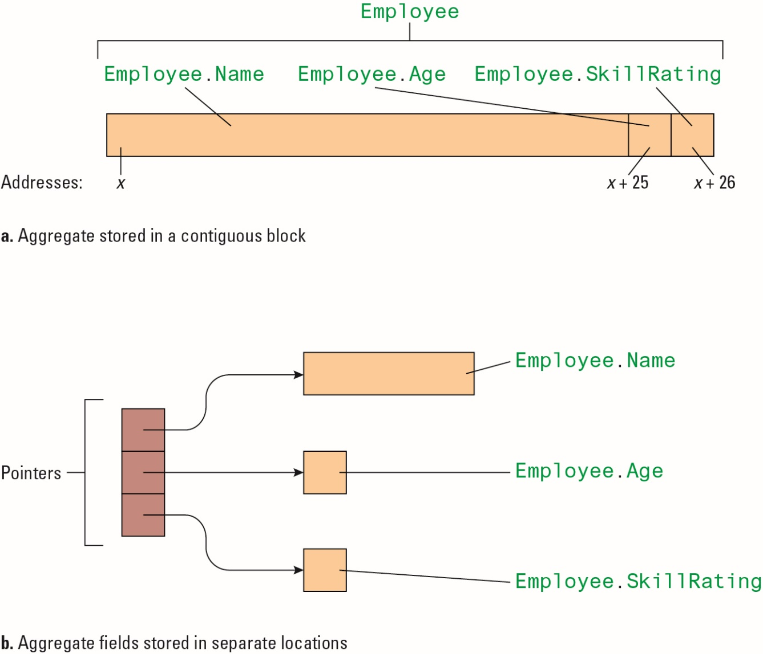
Figure 8.7 Storing the aggregate type Employee

Slide 23
Storing Lists
Contiguous list: List in which entries are stored in an array
Linked list: List in which entries are linked by pointers
  Head pointer: Pointer to first entry in list
  null: A “non-pointer” value used to indicate end of list

Slide 24
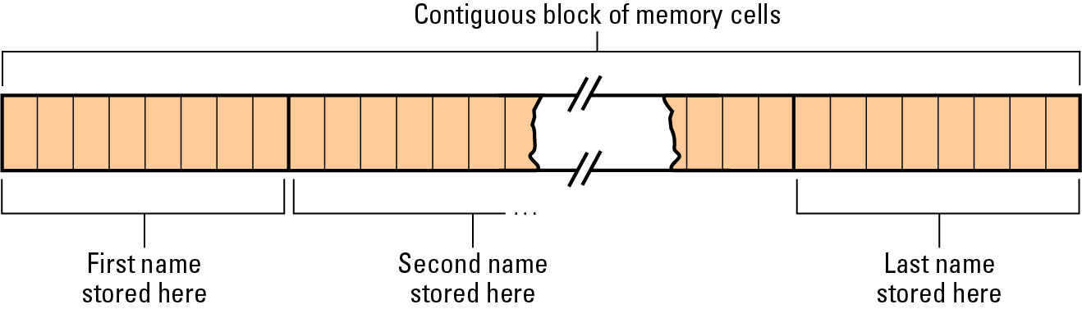
Figure 8.8 Names stored in memory as a contiguous list

Slide 25
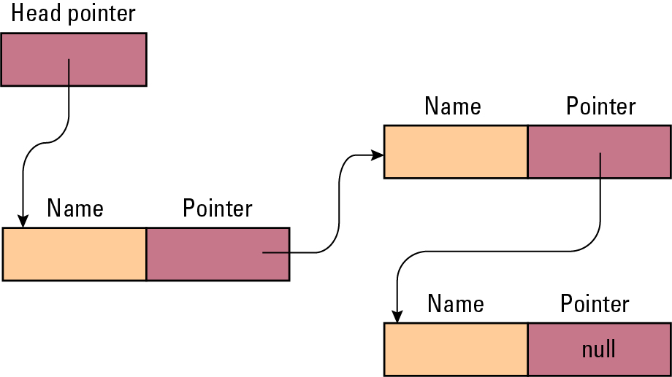
Figure 8.9 The structure of a linked list

Slide 26
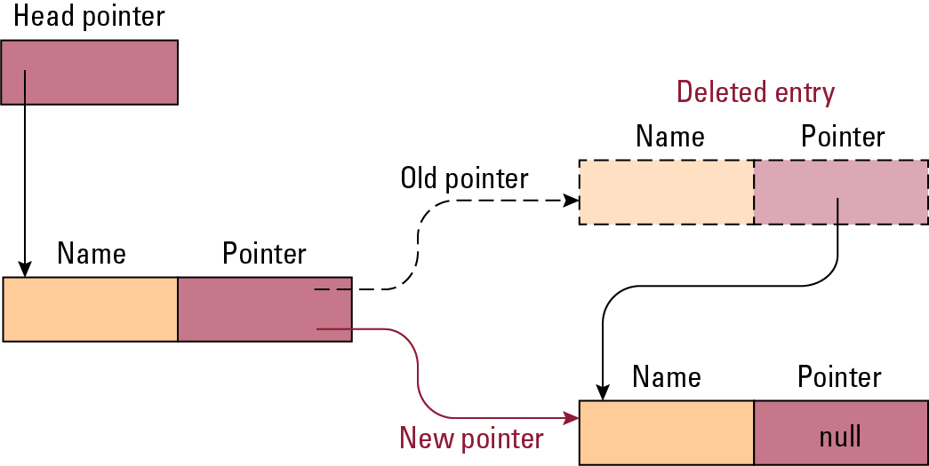
Figure 8.10 Deleting an entry from a linked list

Slide 27
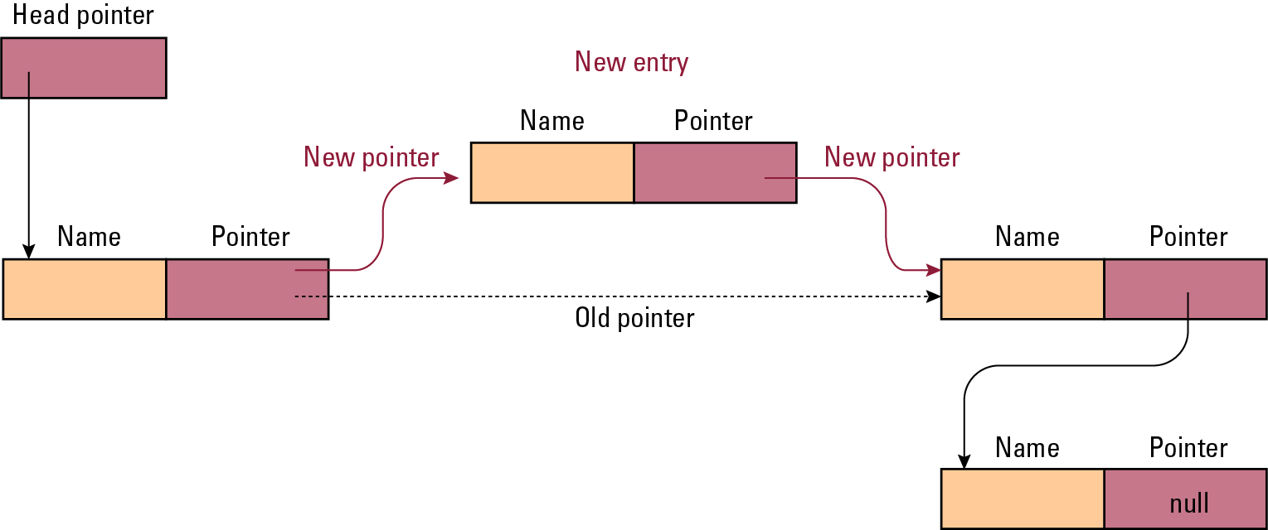
Figure 8.11 Inserting an entry into a linked list

Slide 28
Storing Stacks and Queues
Stacks usually stored as contiguous lists
Queues usually stored as Circular Queues
  Stored in a contiguous block in which the first entry is considered to follow the last entry
  Prevents a queue from crawling out of its allotted storage space

Slide 29
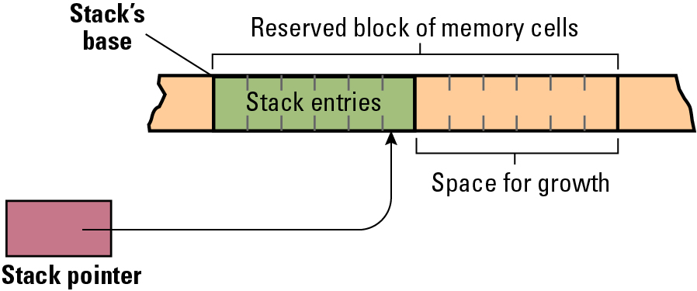
Figure 8.12 A stack in memory

Slide 30
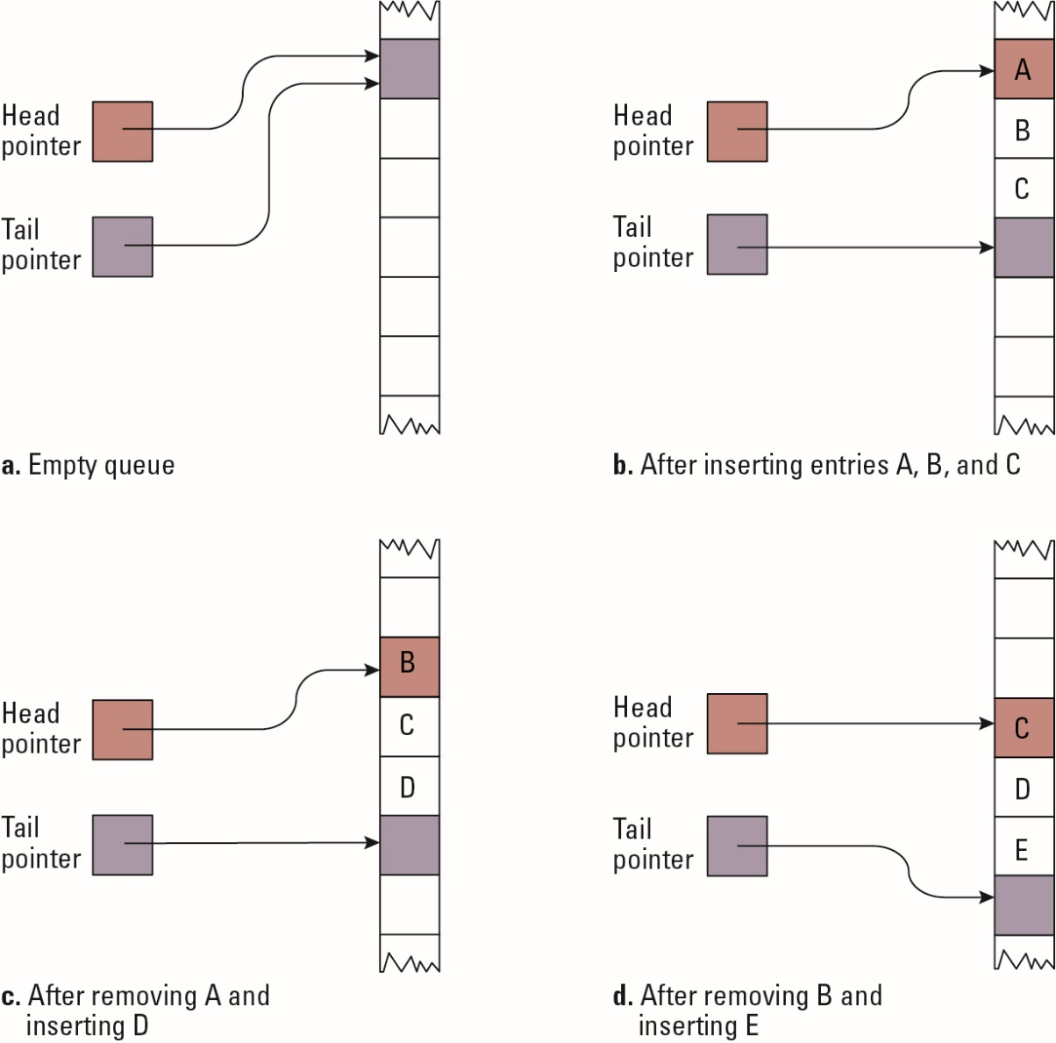
Figure 8.13 A queue implementation with head and tail pointers

Slide 31
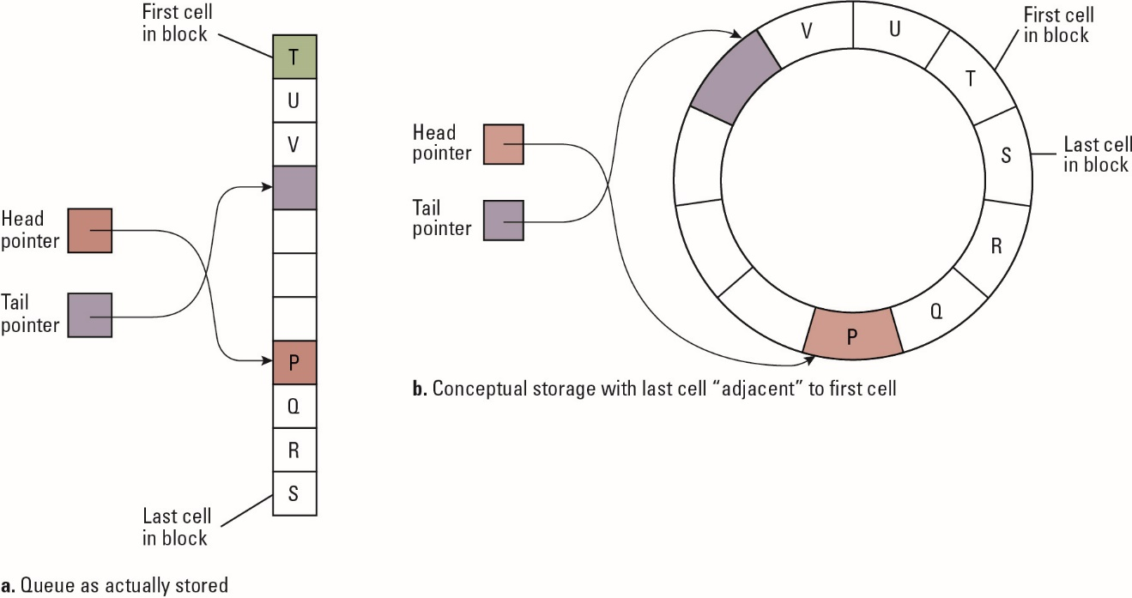
Figure 8.14 A circular queue containing the letters P through V

Slide 32
Storing Binary Trees
Linked structure
  Each node = data cells + two child pointers
  Accessed via a pointer to root node
Contiguous array structure
  A[1] = root node
  A[2],A[3] = children of A[1]
  A[4],A[5],A[6],A[7] = children of A[2] and A[3]

Slide 33
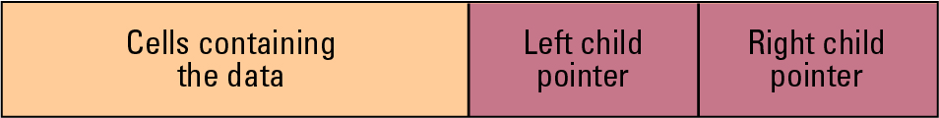
Figure 8.15 The structure of a node in a binary tree

Slide 34
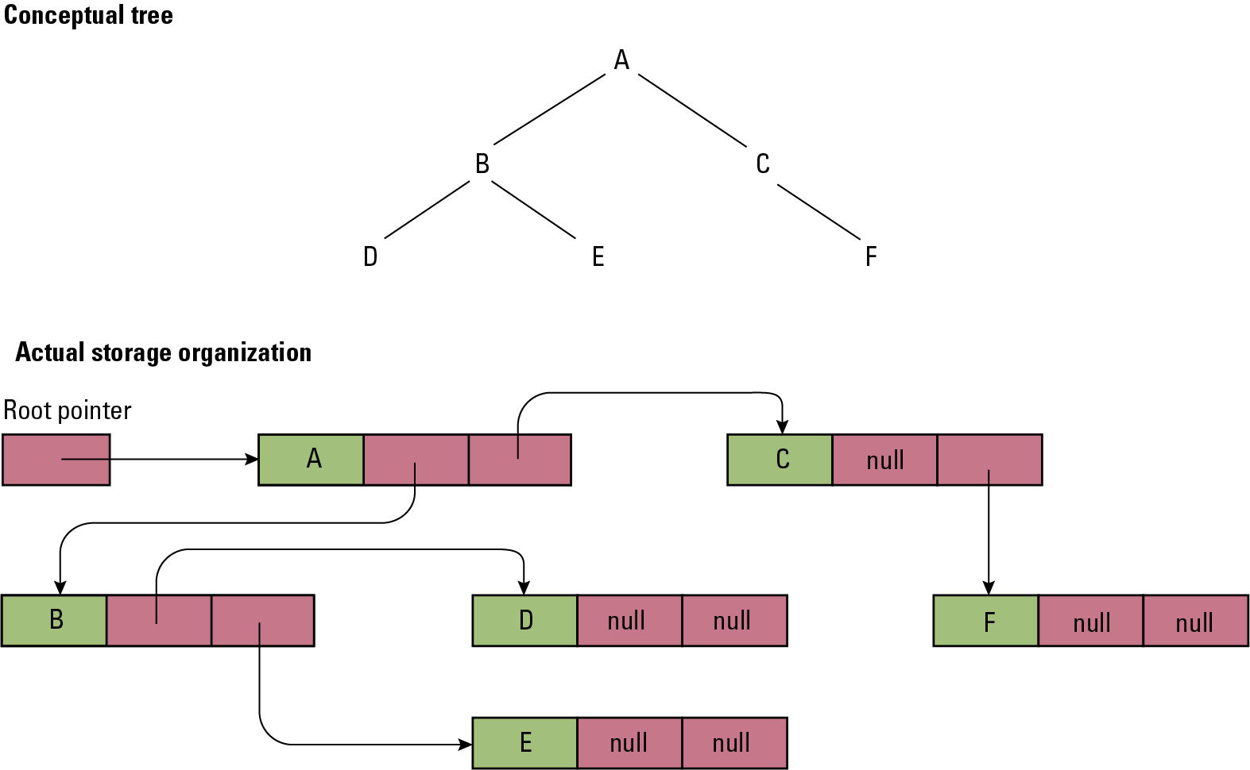
Figure 8.16 The conceptual and actual organization of a binary tree using a linked storage system

Slide 35
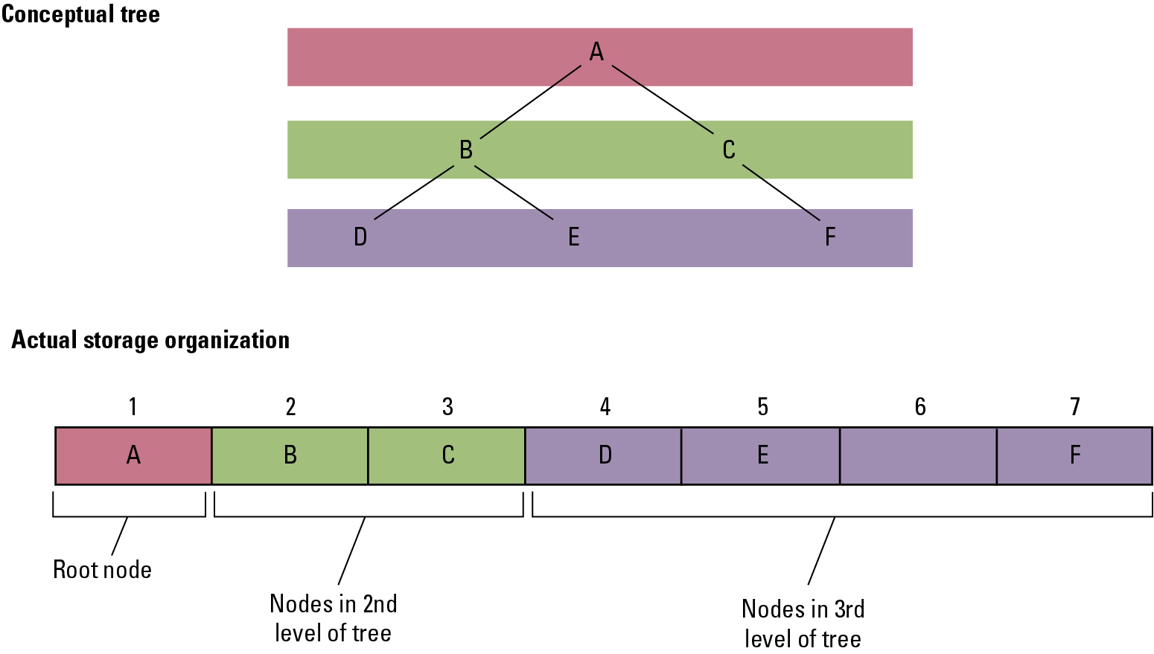
Figure 8.17 A tree stored without pointers

Slide 36
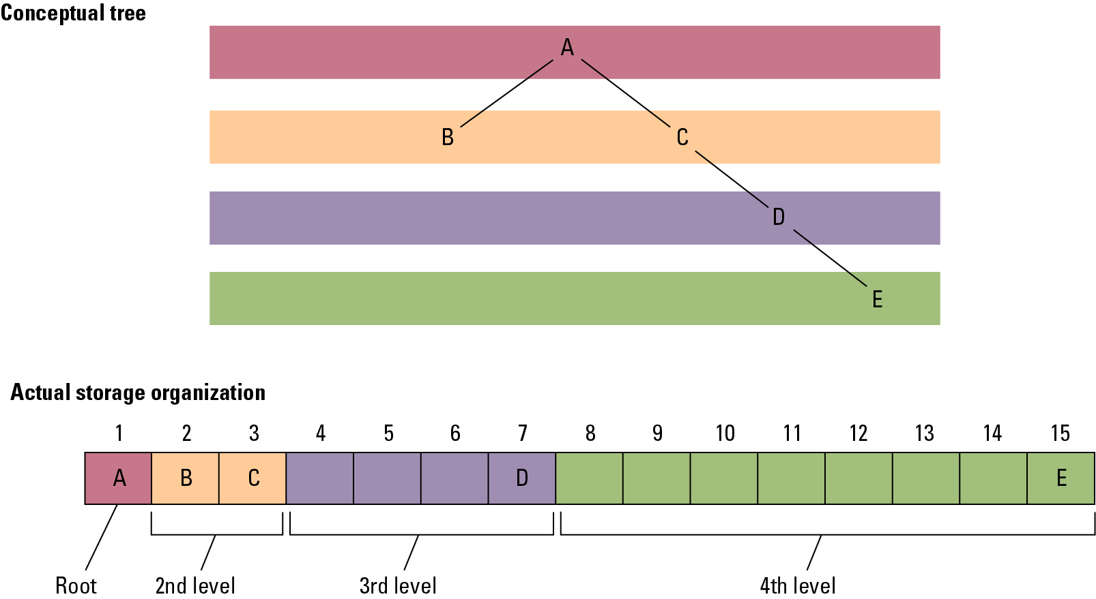
Figure 8.18 A sparse, unbalanced tree shown in its conceptual form and as it would be stored without pointers

Slide 37
Manipulating Data Structures
Ideally, a data structure should be manipulated solely by pre-defined functions
  Example: A list typically has a function insert for inserting new entries
  The data structure along with these functions constitutes a complete abstract tool

Slide 38
Figure 8.19 A function for printing a linked list
def PrintList (List):
CurrentPointer = List.Head
while (CurrentPointer is not None):
print(CurrentPointer.Value)
CurrentPointer = CurrentPointer.Next

Slide 39
8.4 A Short Case Study
Problem:
Construct an abstract tool consisting of a list of names in alphabetical order along with the operations: search, print, and insert.

Slide 40
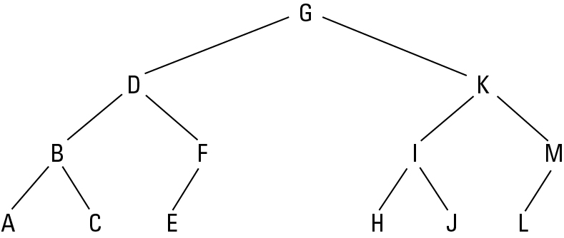
Figure 8.20 The letters A through M arranged in an ordered tree

Slide 41
Figure 8.21 The binary search as it would appear if the list were implemented as a linked binary tree
def Search (Tree, TargetValue):
if (Tree is None):
return None # Search failed
elif (TargetValue == Tree.Value):
return Tree # Search succeeded
elif (TargetValue < Tree.Value):
# Continue search in left subtree
return Search(Tree.Left, TargetValue)
elif (TargetValue > Tree.Value):
# Continue search in right subtree
return Search(Tree.Right, TargetValue)

Slide 42
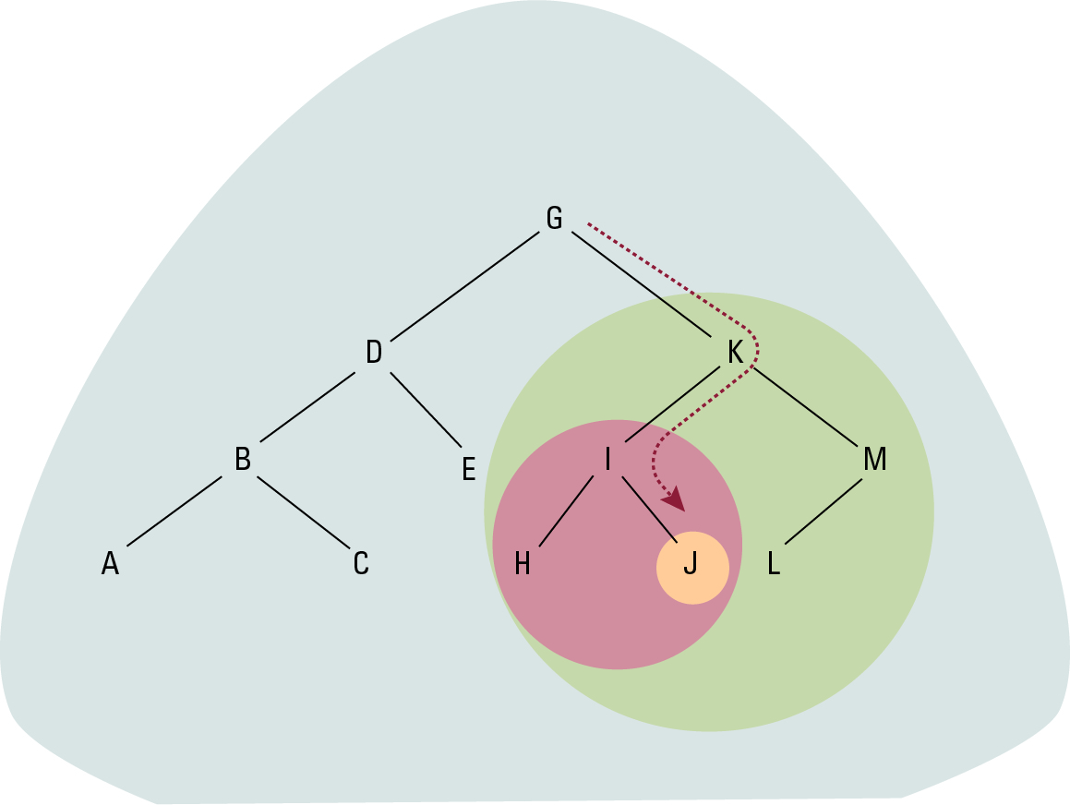
Figure 8.22 The successively smaller trees considered by the function in Figure 8.21 when searching for the letter J

Slide 43
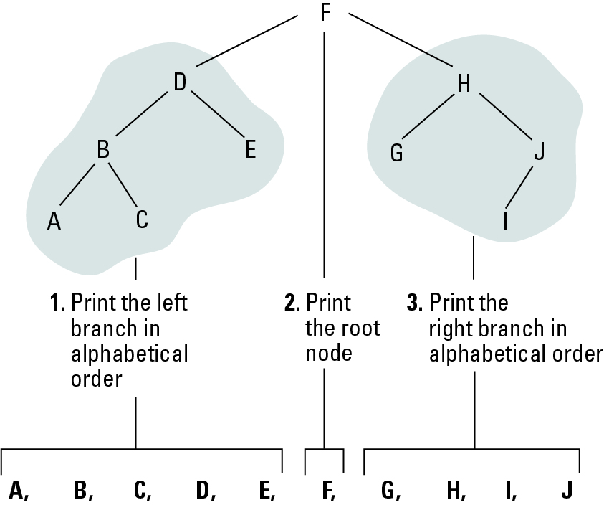
Figure 8.23 Printing a search tree in alphabetical order

Slide 44
Figure 8.24 A function for printing the data in a binary tree
def PrintTree (Tree):
if (Tree is not None):
PrintTree(Tree.Left)
print(Tree.Value)
PrintTree(Tree.Right)

Slide 45
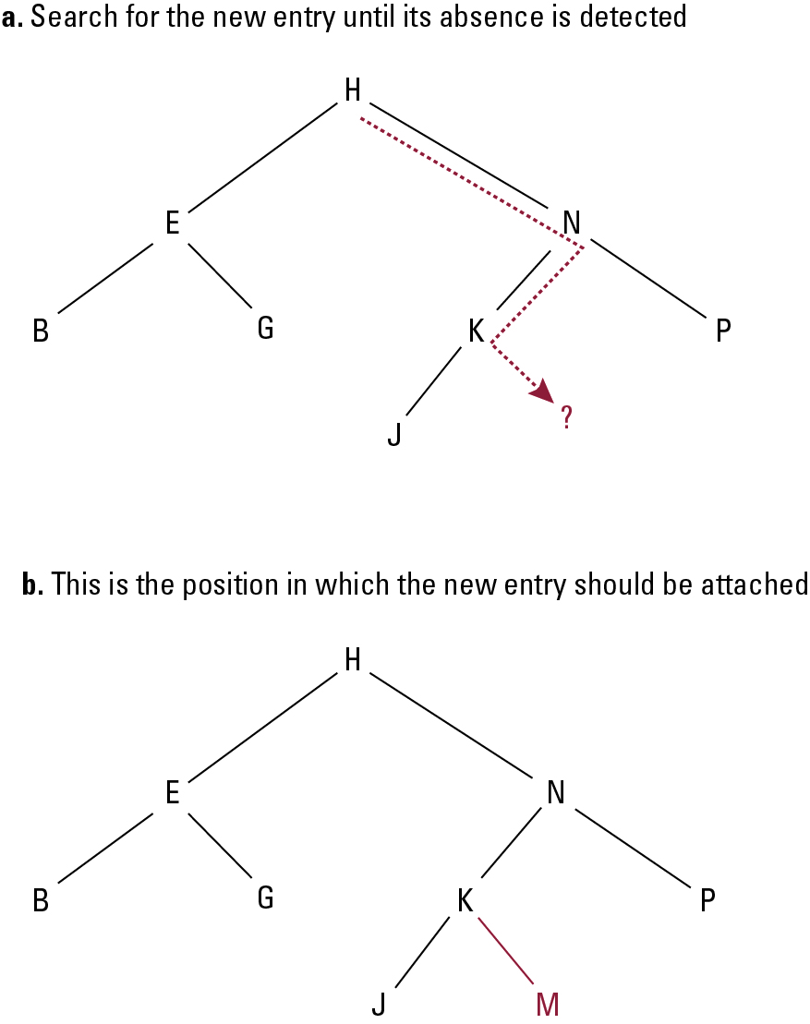
Figure 8.25 Inserting the entry M into the list B, E, G, H, J, K, N, P stored as a tree

Slide 46
Figure 8.26 A function for inserting a new entry in a list stored as a binary tree
def Insert(Tree, NewValue):
if (Tree is None):
# Create a new leaf with NewValue
Tree = TreeNode()
Tree.Value = NewValue
elif (NewValue < Tree.Value):
# Insert NewValue into the left subtree
Tree.Left = Insert(Tree.Left, NewValue)
elif (NewValue > Tree.Value):
# Insert NewValue into the right subtree
Tree.Right = Insert(Tree.Right, NewValue)
else:
# Make no change
return Tree

Slide 47
8.5 Customized Data Types
Primitive Types:
integer, float, character, Boolean
A programmer can define customized data types to meet the needs of a particular application

Slide 48
User-defined Data Type
Use an aggregate structure to define new type, in C:
struct EmployeeType
{
char Name[25];
int Age;
real SkillRating;
}
Use the new type to define variables:
struct EmployeeType DistManager, SalesRep1;

Slide 49
Abstract Data Type
A user-defined data type that can include both data (representation) and functions (behavior)
Example:
interface StackType
{
public int pop();
public int push(int item);
public boolean isEmpty();
public boolean isFull();
}

Slide 50
8.6 Classes and Objecs
Class: an abstract data type with extra features
  Properties can be inherited
  Constructor methods to initialize new objects
  Contents can be encapsulated
Object: an instance of a class

Slide 51
Figure 8.27 A stack of integers implemented in Java and C#
class StackOfIntegers implements StackType
{
private int[] StackEntries = new int[20];
private int StackPointer = 0;
public void push(int NewEntry)
{ if (StackPointer < 20)
StackEntries[StackPointer++] = NewEntry;
}
public int pop()
{ if (StackPointer > 0) return StackEntries[--StackPointer];
else return 0;
}
public boolean isEmpty()
{ return (StackPointer == 0);
}
public boolean isFull()
{ return (StackPointer >= MAX);
}
}

Slide 52
8.7 Pointers in Machine Language
Immediate addressing: Instruction contains the data to be accessed
Direct addressing: Instruction contains the address of the data to be accessed
Indirect addressing: Instruction contains the location of the address of the data to be accessed

Slide 53
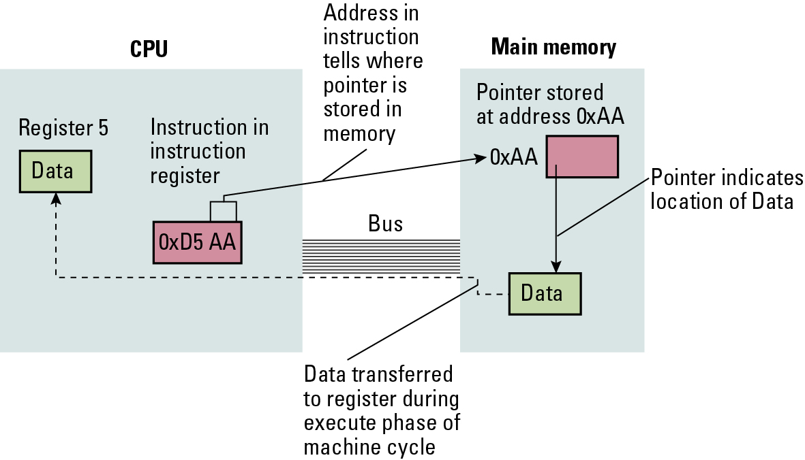
Figure 8.28 Our first attempt at expanding the machine language in Appendix C to take advantage of pointers

Slide 54
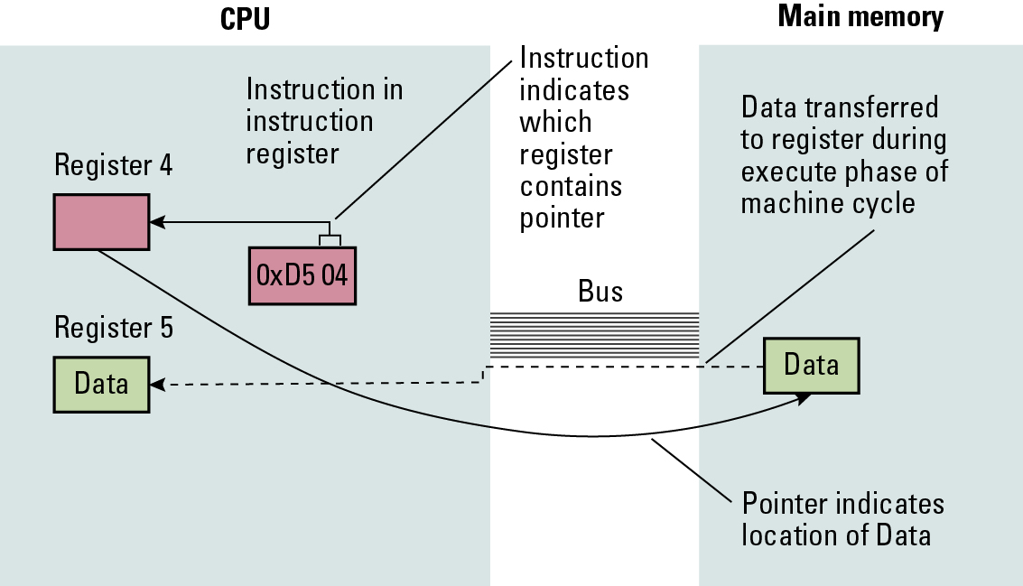
Figure 8.29 Loading a register from a memory cell that is located by means of a pointer stored in a register

